Slide 1
Cross-Platform Native UIs with Xamarin.Forms
Pierce Boggan
@pierceboggan
Program Manager, Microsoft

Slide 2
Meet Xamarin.Forms
Build native UIs for iOS, Android, and Windows
from a single, shared C# codebase.

Slide 3
Xamarin + Xamarin.Forms
iOS C# UI
Android C# UI
Windows C# UI
Shared UI Code
Shared C# Backend
Shared C# Backend
Traditional Xamarin Approach
With Xamarin.Forms: More code-sharing, all native
Notes:
How does Xamarin.Forms compare to the ”traditional” Xamarin approach?
Continue to share all of your non-UI logic as you were before, and now share your UI logic as well.
Still 100% access to the underlying native APIs, still 100% native - uses native controls to render.

Slide 4
What’s included
✓ 40+ Pages, layouts, and controls
(Build from code behind or XAML)
✓ Two-way data binding
✓ Navigation
✓ Animation API
✓ Dependency Service
✓ Messaging Center
Shared UI Code
Shared C# Backend

Slide 5

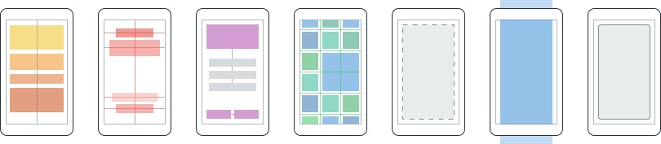
Layouts
Pages
Content
MasterDetail
Navigation
Tabbed
Carousel
Stack
Absolute
Relative
Grid
ContentView
ScrollView
Frame
Notes:
Application is the highest-level in a Xamarin.Forms app, followed by pages, which roughly represent screens, but can also represent navigation flows.
Master-Detail
Navigation
Tabbed
Layouts
Describe how elements are to be laid out within a page.
Simple from StackLayout all the way up to powerful grids.
Two main types:
Managed: most Xamarin.Forms layouts are this. Adaptive to screen size and form factor.
Unmanaged: Absolute

Slide 6
Controls
ActivityIndicator
BoxView
Button
DatePicker
Editor
Entry
Image
Label
ListView
Map
OpenGLView
Picker
ProgressBar
SearchBar
Slider
Stepper
TableView
TimePicker
WebView
EntryCell
ImageCell
SwitchCell
TextCell
ViewCell
Notes:
More than 40+ controls, layouts, and pages to mix-and-match from.
You can also create your own.
Each is a native control that you have access and control over if you want.
Entry = TextBox-like field
On iOS
UITextField
EditText
TextBox

Slide 7


Xamarin.Forms Ecosystem
Notes:
Lots of great vendors building controls for Xamarin.Forms as well.

Slide 8
Control Comparison
Windows | Xamarin.Forms
StackPanel | StackLayout
TextBox | Entry
ListBox | ListView
CheckBox | Switch
ProgressBar | ActivityIndicator
Grid | Grid
Label | Label
Button | Button
Image | Image
Date/TimePicker | Date/TimePicker
Notes:
Controls are super similar to Windows development, with a few naming changes.

Slide 9
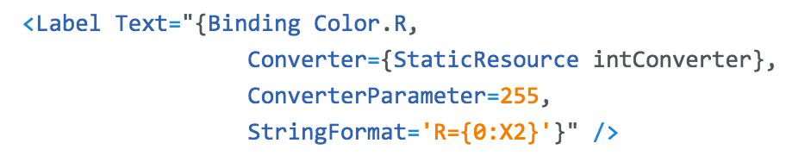
Windows | Xamarin.Forms
DataContext | BindingContext
{Binding Property} | {Binding Property}
ItemsSource | ItemsSource
ItemTemplate | ItemTemplate
DataTemplate | DataTemplate
Binding
Comparison
Notes:
Bindings work exactly the same, with the exception of some unique naming for the binding context.

Slide 10
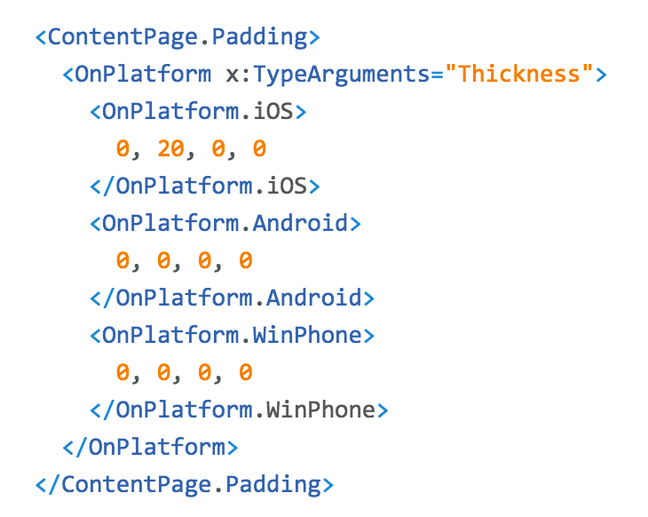
Platform
Customization
Notes:
Lots of opportunity for changing up your user interface on a per-platform basis.
Using this in the Evolve app to show flyout on Android/Windows and tabs on iOS.

Slide 11
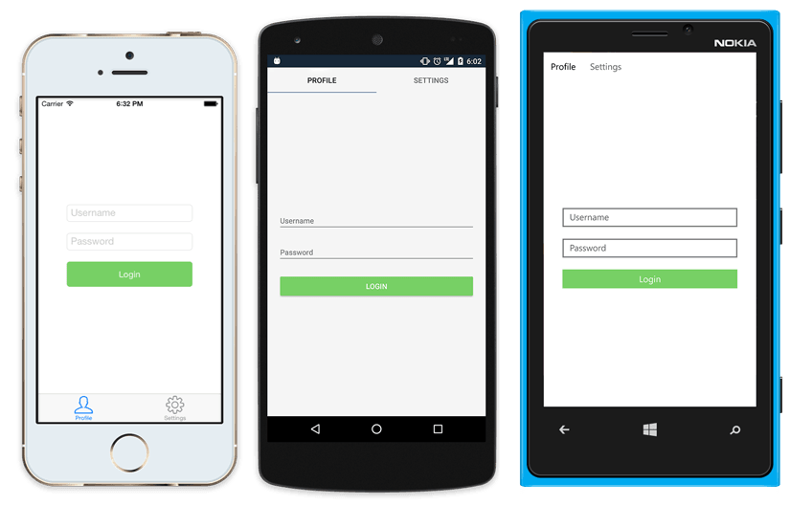
Native UI from shared code
<?xml version="1.0" encoding="UTF-8"?>
<TabbedPage xmlns="http://xamarin.com/schemas/2014/forms"
xmlns:x="http://schemas.microsoft.com/winfx/2009/xaml"
x:Class="MyApp.MainPage">
<TabbedPage.Children>
<ContentPage Title="Profile" Icon="Profile.png">
<StackLayout Spacing="20" Padding="20"
VerticalOptions="Center">
<Entry Placeholder="Username"
Text="{Binding Username}"/>
<Entry Placeholder="Password"
Text="{Binding Password}"
IsPassword="true"/>
<Button Text="Login" TextColor="White"
BackgroundColor="#77D065"
Command="{Binding LoginCommand}"/>
</StackLayout>
</ContentPage>
<ContentPage Title="Settings" Icon="Settings.png">
<!-- Settings -->
</ContentPage>
</TabbedPage.Children>
</TabbedPage>
Notes:
This is what a login page looks like with the XAML on the right.
Tabs are natively displayed.
On top for iOS.
On bottom for Android.
Pivot control for Windows Phone.
All rendered using native controls.

Slide 12
Let’s build an app!
Notes:
MyWeather demo

Slide 13
What’s new in Xamarin.Forms?
Notes:
We just saw the basics of Xamarin.Forms… what’s new?

Slide 14
Performance
Notes:
Performance was front-and-center in Xamarin.Forms 2.0

Slide 15
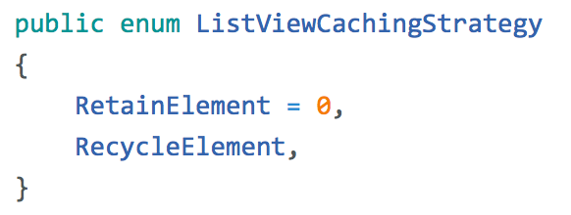
ListView CachingStrategy
✓ Improves scrolling performance
✓ Old behavior is currently the default (but likely to change)
Notes:
ListViews are a main component of most apps.
Thus, optimizing those leads to huge boosts in performance.
This release brings ListView cell caching to improve scrolling performance and reduce memory footprint.

Slide 16
XAML Compilation
XAML
XAMLC
Compile-time
Parsed & turned into IL
Runtime
Parsed and inflated
Notes:
XAML compilation changes the way the XAML actually brings your UI to life.
XAML is typically parsed and inflated, meaning there’s a runtime hit.
XAMLC is precompiled and turned into IL.

Slide 17
Benefits
✓ Faster Loading
✓ Smaller App Size
✓ See XAML errors at build time
Notes:
Faster loading.
Don’t have to parse and inflate at runtime.
Smaller app sizes.
Find errors at compile-time, not runtime.

Slide 18
Design & Controls
Notes:
New ways to bring your user interface design to life.

Slide 19
Data Templates
Notes:
Data templates allow you to have multiple cell types in the same list view.
Obvious example is chat.

Slide 20
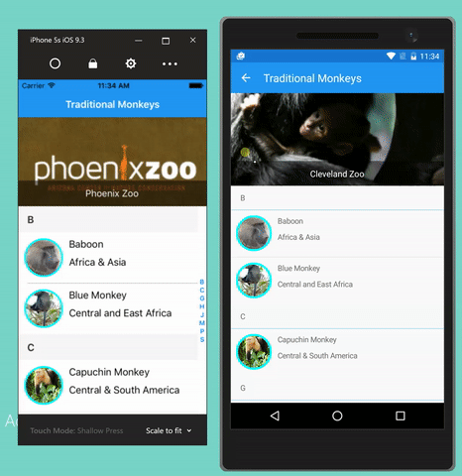
CarouselView
Embeddable Carousel
ItemTemplate & DataTemplates
Highly customizable & Virtualized
Notes:
We have CarouselPage, but now we have CarouselViews.

Slide 21
Effects I
✓ Custom renderer “lite”
✓ Change properties on the native control
✓ Optional
✓ “stringly-typed”
X No methods or events
X No replacing the control
Notes:
Effects make bringing easy platform-specific tweaks to life easy.
Change properties on native controls – no methods or overrides here.

Slide 22
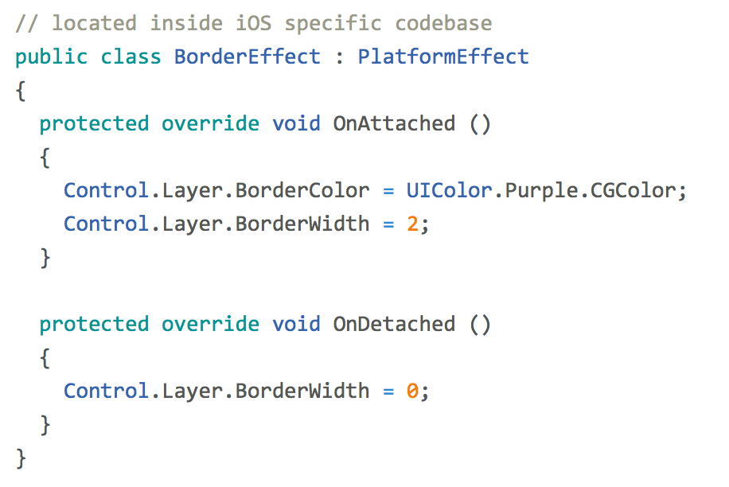
Effects II
entry.Effects.Add (Effect.Resolve("Xamarin.BorderEffect"));
Notes:
Simply apply the effect to a particular control.

Slide 23
So much more
Notes:
Great new tooling and features to make Xamarin.Forms even better!

Slide 24
XAML Previewer
Notes:
See XAML come to life as you type.
Great for visualizing XAML in real time.

Slide 25
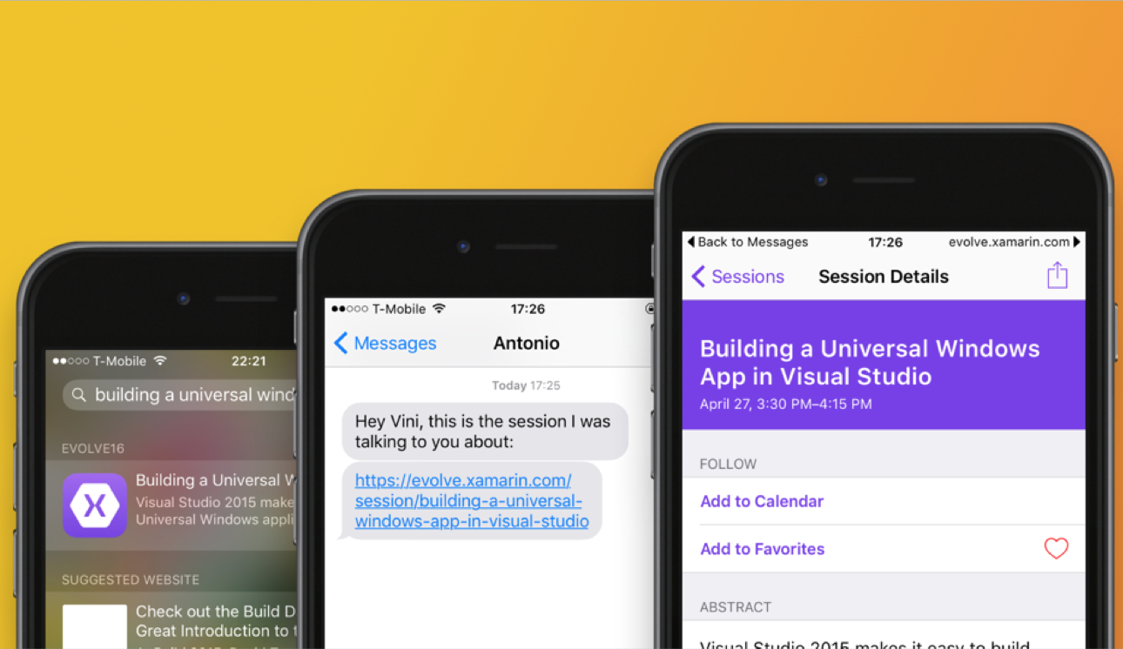
URL Navigation
Notes:
Mobile is all about search. Helping users find content easier leads to higher app usage.
Simple cross-platform API over:
CoreSpotlight
NSUserActivity
Google App Indexing

Slide 26
DataPages
https://developer.xamarin.com/guides/xamarin-forms/datapages/
Notes:
Great for quick prototyping of existing APIs.
Just pass API to data pages and have it do the heavy lifting.

Slide 27
Themes
https://developer.xamarin.com/guides/xamarin-forms/themes/
Notes:
Themes help your app look great!
We ship two out of the box: light and dark.
You can always create your own to enforce a consistent theme across multiple apps with different teams.

Slide 28
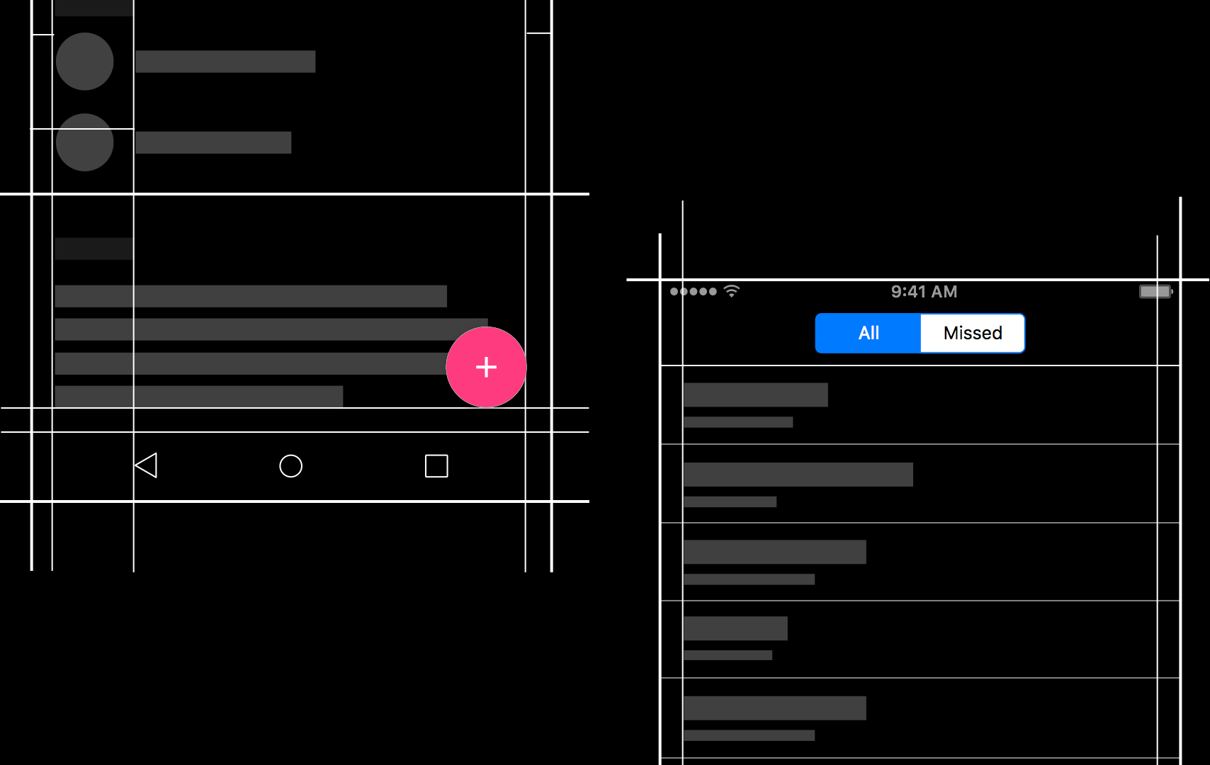
Native Embedding
Notes:
Easily embed any native control into a Xamarin.Forms layout.
We’ll take a closer look at this in our hands-on workshop.

Slide 29
Let’s take a 10 minute break!
Notes:
Great new tooling and features to make Xamarin.Forms even better!

